Slide 1
Team Assignment 5
ZhenYang, KaiSheng, Haidah, YongQing

Slide 2
Problem Statement
Conduct a survey and study on the popularity or utilisation on one topic.
Topic | Sub-Categories
Popularity of Co-curricular activities in RP | • Sports and Health
 | • Adventure Learning
 | • Aesthetics and Culture

Slide 3
Problem Statement
We have decided to use one-way analysis of variance (ANOVA)which is used to determine whether there are any statistically significant differences between the means of three or more independent (unrelated) groups.
For example, we can use the one-way ANOVA test to understand whether popularity levels differed based on popularity ratings amongst students, dividing students into three independent groups (e.g.Sports and Health, Adventure Learning, Aesthetics and Culture).

Slide 4
Assumptions
The populations are independent.
The populations follow normal distributions.
The populations have equal variances.

Slide 5
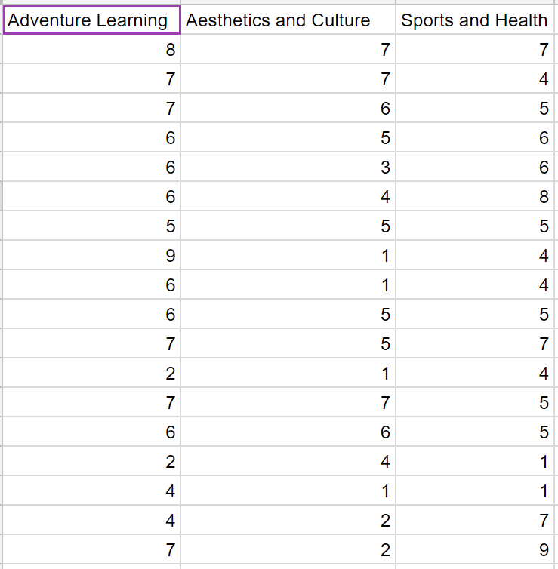
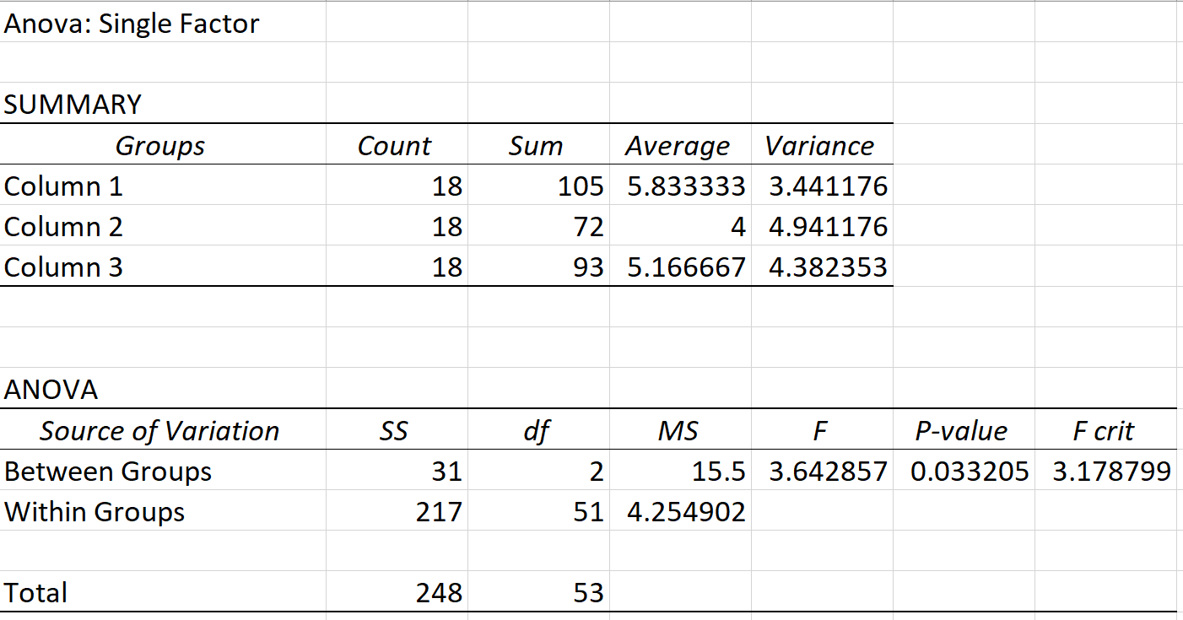
Data analysis

Slide 6
Comparing the popularity rating of ‘adventure learning and ‘Aesthetics and culture
Null hypothesis : μ1 - μ2 = 0
Alternative hypothesis : μ1 -μ2 not equals to 0
t_{α/2 =}T.INV.2T (0.05,51)
= 2.007584
(x1 - x2) = (5.83333 - 4) +/- (2.007584)[sqrt 4.254902(1/18 +1/18)]
= (0.45295, 3.213705)
= (0.45, 3.21)
Since 0 lies outside the interval, we conclude that there is significance difference between the mean popularity rating of ‘adventure learning’ and ‘Aesthetics and culture’. Furthermore, since both limits are positive, we can conclude that the ‘adventure learning’ popularity rating has a higher mean popularity rating than the ‘aesthetics and culture’ popularity rating.

Slide 7
Comparing the popularity rating of ‘Aesthetics and culture’ and ‘sports and health’
Null hypothesis : μ2 - μ3 = 0
Alternative hypothesis : μ2 - μ3 not equal to 0
t_{α/2 =}T.INV.2T (0.05,51)
= 2.007584
(X2 - X3) = (4 - 5.166667)+/- (2.007584) [sqrt 4.254902 ((1/18)+(1/18)]
=(-2.54704253,0.2137085301)
=(-2.55, 0.214)
Since 0 lies inside the interval, we can conclude that isn’t any significance difference between the mean popularity rating of ‘Aesthetics and Culture’ and ‘Sports and Health’

Slide 8
Comparing the popularity rating of ‘adventure learning’ and ‘sports and health’
Null hypothesis : μ1 - μ3 = 0
Alternative hypothesis : μ1 - μ3 not equals to 0
(x1-x3) = (5.83333-5.166667) +/- (2.007584)[sqrt 4.254902(1/18 + 1/18)]
= (-0.71, 2.05) (2dp)
Since 0 lies inside the interval, we can conclude that isn’t any significance difference between the mean popularity rating of ‘Adventure learning’ and ‘Sports and Health’

Slide 9
THANK YOU! :)

